Slide 1


.NET Overview and Tools
Speaker Name
Notes:
Welcome to .NET Conf 2021! I’m Scott Hunter, VP of Product at Microsoft. I’m excited to share all the great things we’ve built with the open-source community for the .NET 6 release.

Slide 2


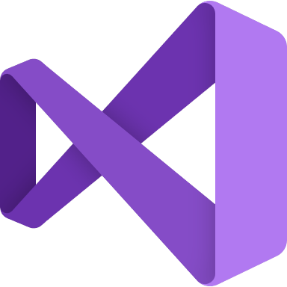





.NET – A unified development platform
ECOSYSTEM
TOOLS
CLOUD
WEB
MOBILE
GAMING
IoT
AI
NuGet
Visual Studio
DESKTOP
Azure
ASP.NET
Blazor
.NET MAUI
WPF
WinForms
.NET MAUI
Xamarin
Unity
ARM32
ARM64
ML.NET
.NET for Apache Spark
GitHub
Visual Studio for Mac
.NET 6
COMMON BASE LIBARIES/APIs
Components, tools, library vendors
Visual Studio Code
INFRASTRUCTURE
RUNTIME COMPONENTS
COMPILERS
LANGUAGES
CLI
Notes:
Cross-platform and open source, .NET is a unified development platform for building anything. You can use the same tools, libraries, languages and runtime to build any application across web, mobile, desktop, AI/ML, data, gaming, and IoT workloads. .NET is a general-purpose programming platform that enables all kinds of application scenarios. Once you learn one, you can easily pick up another. To enable specific app scenarios, app models (or app frameworks) are built on top of the base libraries and runtime to extend what .NET can do. With .NET 6, we’ve unified the SDK, common base libraries, and runtime on which all of these app models sit.
.NET has a vast ecosystem of thousands of library packages you get via NuGet and open-source projects in development on GitHub. There are also hundreds of vendors providing additional components, tools, libraries and services. You can use a broad set of IDEs and editors with .NET including best-in-class tools with Visual Studio, Visual Studio for Mac and the cross-platform editor Visual Studio Code.

Slide 3

.NET ecosystem momentum
5.4M
#1
Top 30
.NET developers
In Visual Studio family
Most Loved Framework (2019, 20, 21)
.NET Core / .NET 5
Highest velocity OSS project since 2017
github.com/dotnet
>6.9K
Community contributors
>21K
Community contributions
.NET 6
Sources: insights.stackoverflow.com/survey/2019#most-loved-dreaded-and-wanted; insights.stackoverflow.com/survey/2020#most-loved-dreaded-and-wanted;
insights.stackoverflow.com/survey/2021#section-most-loved-dreaded-and-wanted-other-frameworks-and-libraries;
www.cncf.io/blog/2021/08/02/update-on-cncf-and-open-source-project-velocity-2020/
Notes:
I’d like to highlight some big accomplishments we’ve made with the .NET community. The .NET ecosystem has seen some significant momentum in the last few years.
There are now 5.4 million monthly active developers in Visual Studio family of tools.
.NET Core / .NET 5 has ranked #1 three years in a row as the most loved framework on the StackOverflow developer survey.
Cloud Native Computing Foundation (CNCF) tracks the highest velocity projects on all of GitHub. They measure this by the rate pull requests and issues come in & how many are accepted. The dotnet repos have been consistently in the top 30 since 2017.
<CLICK>
There are also over 6,900 people outside Microsoft that made over 21,000 contributions! They either filed issues or submitted pull requests to the .NET related repositories for the .NET 6 release.

Slide 4

.NET 6 Performance
+92%
>10X faster than Node.js
ASP.NET Core web framework
Entity Framework Core Performance
Sources:
https://www.techempower.com/benchmarks/#section=data-r20&hw=ph&test=plaintext
https://www.techempower.com/benchmarks/#section=test&runid=3fc99e53-f60d-428e-9937-e809880d3da2&hw=ph&test=fortune&a=2&o=e
Notes:
We’re always focused on having the best performance. Here you can see the TechEmpower performance comparison with Java and Node.js. Better performance leads to lower compute costs and .NET gets better every release. Many of these improvements were made by the community!
.NET 6’s web framework, ASP.NET Core, is STILL over 10 times faster than Node.js.
We’ve also worked really hard on Entity Framework Core performance:
EF Core performance on .NET 6 has improved a whopping 92% over .NET 5!
Query performance is 36% better than .NET 5
The .NET+ASP.NET+EF stack is the 2nd most highly-performing entry in the “Full ORM” category
(it’s 5th place, but the 1st four are the same). Seb thinks that the first may not qualify for “Full ORM” status, so we may actually be the top runner here.)

Slide 5



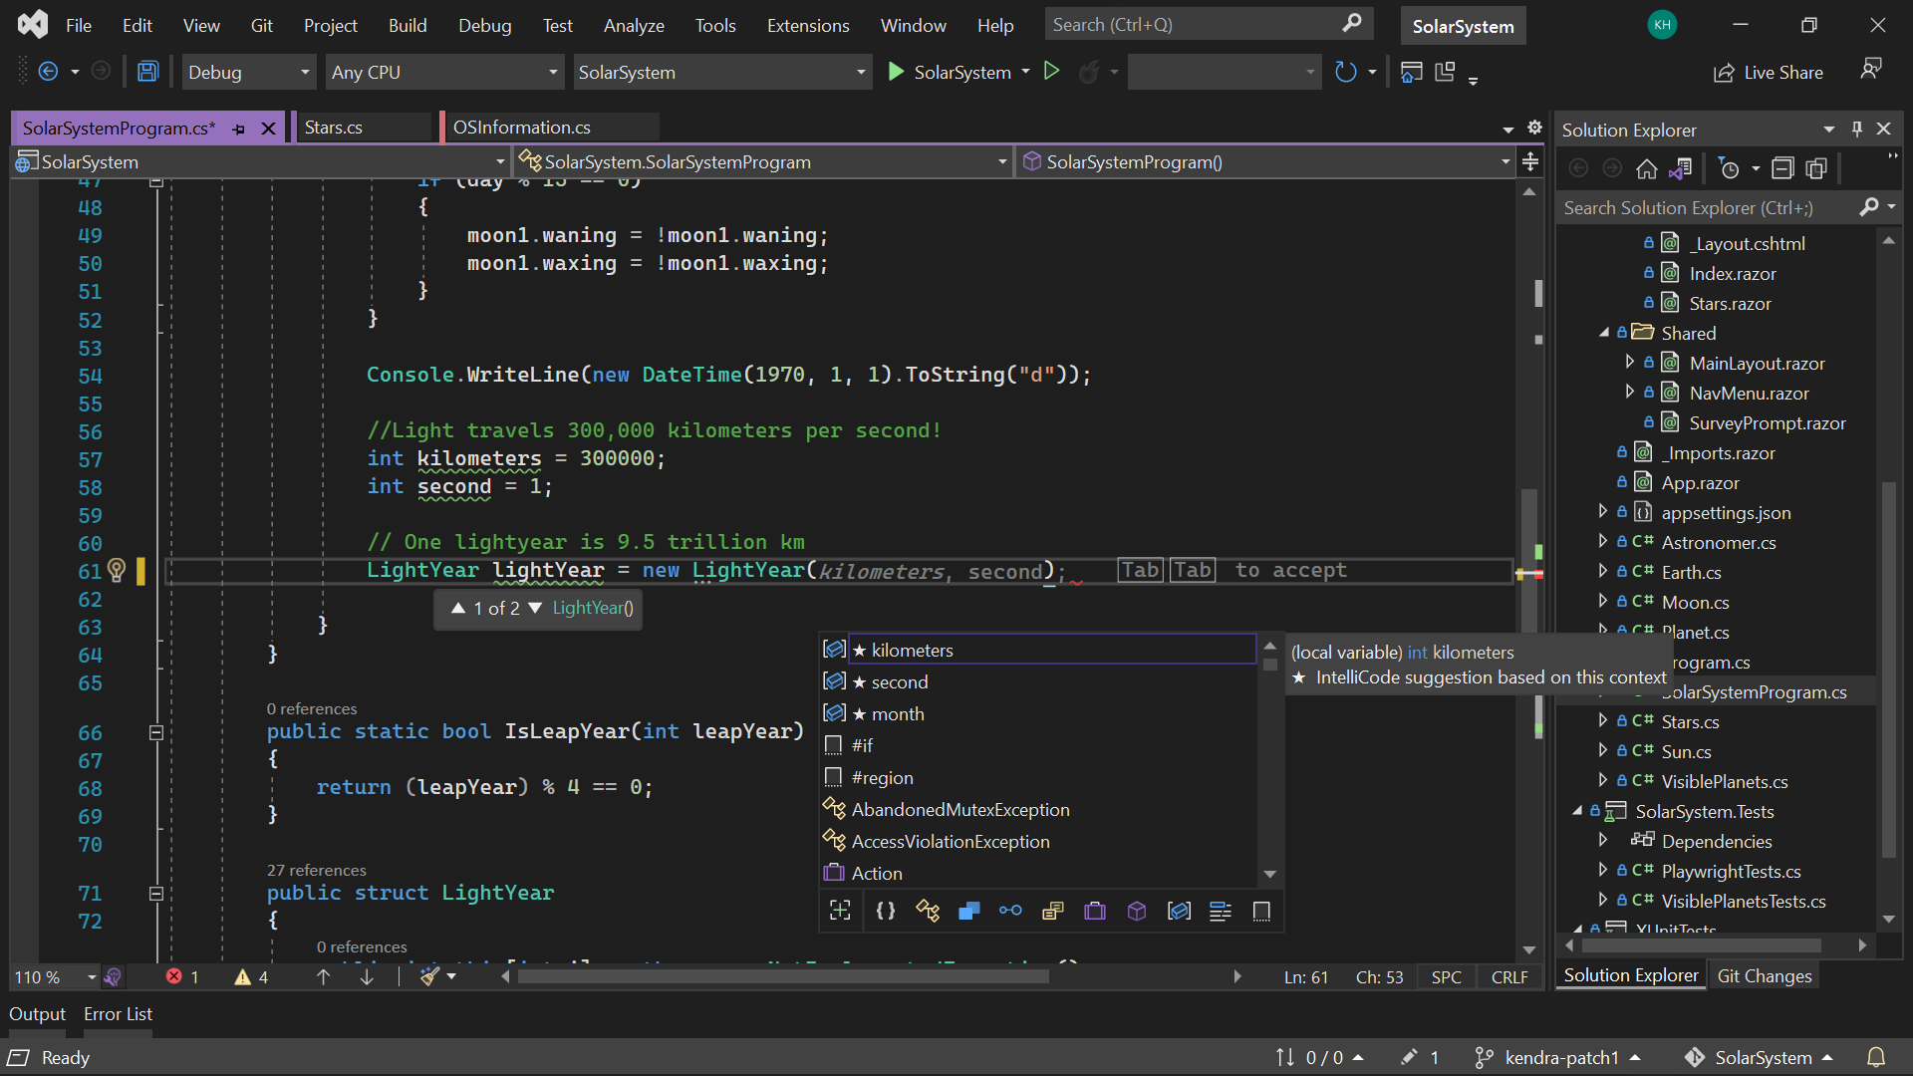
Visual Studio 2022
RELEASED
Modern development
Build innovative, modern apps using .NET 6, GitHub and Azure with integrated tooling
Personal and team productivity
Live Share, Hot reload everywhere, Web live preview, IntelliCode, enhanced debugging and testing tools
Scale to projects of any size
An optimized, modern UI built on 64-bit architecture to support the largest, most complex codebases and workflows
VisualStudio.com/download
Notes:
...and along with .NET 6, we've released the next major version of Visual Studio, VS 2022
VS 2022 is the best IDE for .NET development, with support for the latest project types for:
- cross-platform mobile and desktop apps w/ .NET MAUI
- responsive web UIs with Blazor
- build, run, debug .NET apps in Linux environments with WSL integration
- edit running ASP.NET Framewerk web forms in an updated web designer using web live preview
It helps you stay productive and collaborative with:
- Hot reload (will talk about more in a bit)
- IntelliCode (whole line completions, suggestions for common code refactorings on the fly)
- built-in Git and GitHub integration to clone repos, manage work items and pull requests, and automatically set up CI/CD workflows to GitHub Actions and Azure
And VS 2022 is the first 64-bit version of Visual Studio, so it can take advantage of the full power of your dev box to work on projects of any size and scale.
Go to visualstudio.com and download it today!

Slide 6
The future of .NET Framework
.NET Framework 4.8 is the last major version of .NET Framework on Windows
Support policy remains the same:
Will always be in Windows
Will be patched with Windows
Will be supported with Windows
Keep existing applications on .NET Framework
Recommend .NET 6 for new applications
Notes:
Now let’s talk about C#! From now on, we’ll release a new major version of C# every year along with each version of .NET. This allows us to ship small features more frequently, getting value to you faster.
C# 10 has a strong focus on simplification.
Global usings are usings that you write once and they apply to your whole project
Project types offer implicit usings so you don’t need to type them anywhere
File-scoped namespaces apply to the whole file; no indentation needed
Records can now be structs
You can say that records are classes instead of leaving it implied
Lambdas that contain enough type information have their own types

Slide 7
What comes next for .NET?

Slide 8
The .NET Roadmap
Many
.NETs
2014
.NET FRAMEWORK
.NET CORE (1.x – 3.x)
XAMARIN / MONO
Runtime
Runtime
Runtime
Base class library
Core library
Mono class library

Slide 9
The .NET Roadmap
Many
.NETs
.NET
standard
2014
2016
.NET FRAMEWORK
.NET CORE (1.x – 3.x)
XAMARIN / MONO
Runtime
Runtime
Runtime
Base class library
Core library
Mono class library
.NET STANDARD

Slide 10
The .NET Roadmap
Many
.NETs
.NET
standard
.NET
2014
2016
Next
.NET FRAMEWORK
.NET CORE (1.x – 3.x)
.NET
XAMARIN / MONO
Runtime
Runtime
Runtime (JIT & native)
Runtime
Core library
Base class library
One base class library
Mono class library
.NET STANDARD

Slide 11
.NET 6
Unified common base libraries & SDK
Industry leading performance
Simplified development, easier to get started
New C# 10, F# 6 releases
Apple Silicon (Arm64) support
Long-Term Support Release
get.dot.net/6
Notes:
I’m pleased to announce the general availability of .NET 6.
Talk to big features in bullets
Go get it and start building!

Slide 12
.NET 6 Project System
Notes:
6 min mark
Now let’s talk about how .NET 6 has made development simpler….

Slide 13



.NET 6 Themes
Modern Client Development
Simplified Development
Notes:
We’re always focused on having the best performance. Here you can see the TechEmpower performance comparison with Java and Node.js. Better performance leads to lower compute costs and .NET gets better every release. Many of these improvements were made by the community!
.NET 6’s web framework, ASP.NET Core, is STILL over 10 times faster than Node.js.
We’ve also worked really hard on Entity Framework Core performance:
EF Core performance on .NET 6 has improved a whopping 92% over .NET 5!
Query performance is 36% better than .NET 5
The .NET+ASP.NET+EF stack is the 2nd most highly-performing entry in the “Full ORM” category
(it’s 5th place, but the 1st four are the same). Seb thinks that the first may not qualify for “Full ORM” status, so we may actually be the top runner here.)

Slide 14
Sample Source Code - .NET 5
using System;
class Program
{
static void Main(string[] args)
{
Console.WriteLine("Hello World!");
}
}

Slide 15
Sample Source Code - .NET 6
Console.WriteLine("Hello World!");

Slide 16
CSProj – default console template
<Project Sdk="Microsoft.NET.Sdk">
<PropertyGroup>
<OutputType>Exe</OutputType>
<TargetFramework>net6.0</TargetFramework>
<Nullable>enable</Nullable>
<ImplicitUsings>enable</ImplicitUsings>
</PropertyGroup>
</Project>
Notes:
Point out the following:
Microsoft.NET.SDK pulls in a set of default settings, such as including *.cs files in the project, and appropriate reference assemblies
Exe produces an EXE build. Libraries are the default
netcoreapp2.0 is the target framework, so defines the set of reference assemblies you get

Slide 17
CSProj – default Web template
<Project Sdk="Microsoft.NET.Sdk.Web">
<PropertyGroup>
<TargetFramework>net6.0</TargetFramework>
<Nullable>enable</Nullable>
<ImplicitUsings>enable</ImplicitUsings>
</PropertyGroup>
</Project>
Notes:
Point out the following:
Microsoft.NET.SDK.Web pulls in a set of default settings, including referencing Microsoft.Net.SDK under the hood
Demonstrates PackageReference syntax, the new way to reference NuGet packages. ASP.NET remains in NuGet.
Uses new AspNetCore.All metapackage

Slide 18
Modern client development

Slide 19



Blazor – full stack web apps with .NET
Blazor Server
Blazor WebAssembly
Blazor
Blazor
DOM
SignalR
.NET
Razor Components
DOM
.NET
Razor Components
WebAssembly
Full access to server capabilities
Fast to startup
Code never leaves the server
Supports older browsers & thin clients
Requires persistent connection
Higher UI latency
Runs fully client-side
No required server component
Host as a static site
Can execute offline
Larger download size
Slower runtime performance
Blazor WebAssembly ahead-of-time (AOT) compilation
Smaller Blazor WebAssembly app download size
Error boundaries
Razor component type inference & generic type constraints
Dynamic components
Blazor state persistence during prerendering
.NET 6
Notes:
Blazor lets you write full stack web apps with C# instead of JavaScript and it has become a very popular. In fact, it’s one of the fastest growing workloads in .NET today. It has supported two models since spring 2020, Blazor Server and Blazor WebAssembly which runs completely in the browser. Blazor has a shared component model across the server and the client browser. Depending on your application’s needs, you can choose the right model for you.
<CLICK>
We’ve released event more features for your Blazor web apps in .NET 6 and we’ll show a demo of those in a few minutes. Some include:
You can now ahead-of-time compile your Blazor WebAssembly apps to WebAssembly for significantly improved runtime performance.
The download size of Blazor WebAssembly apps is also smaller even though we’ve added support for over 500 new APIs in .NET 6.
When prerendering Blazor components from the server you can now persist the state of those components so it can be reused on the client

Slide 20
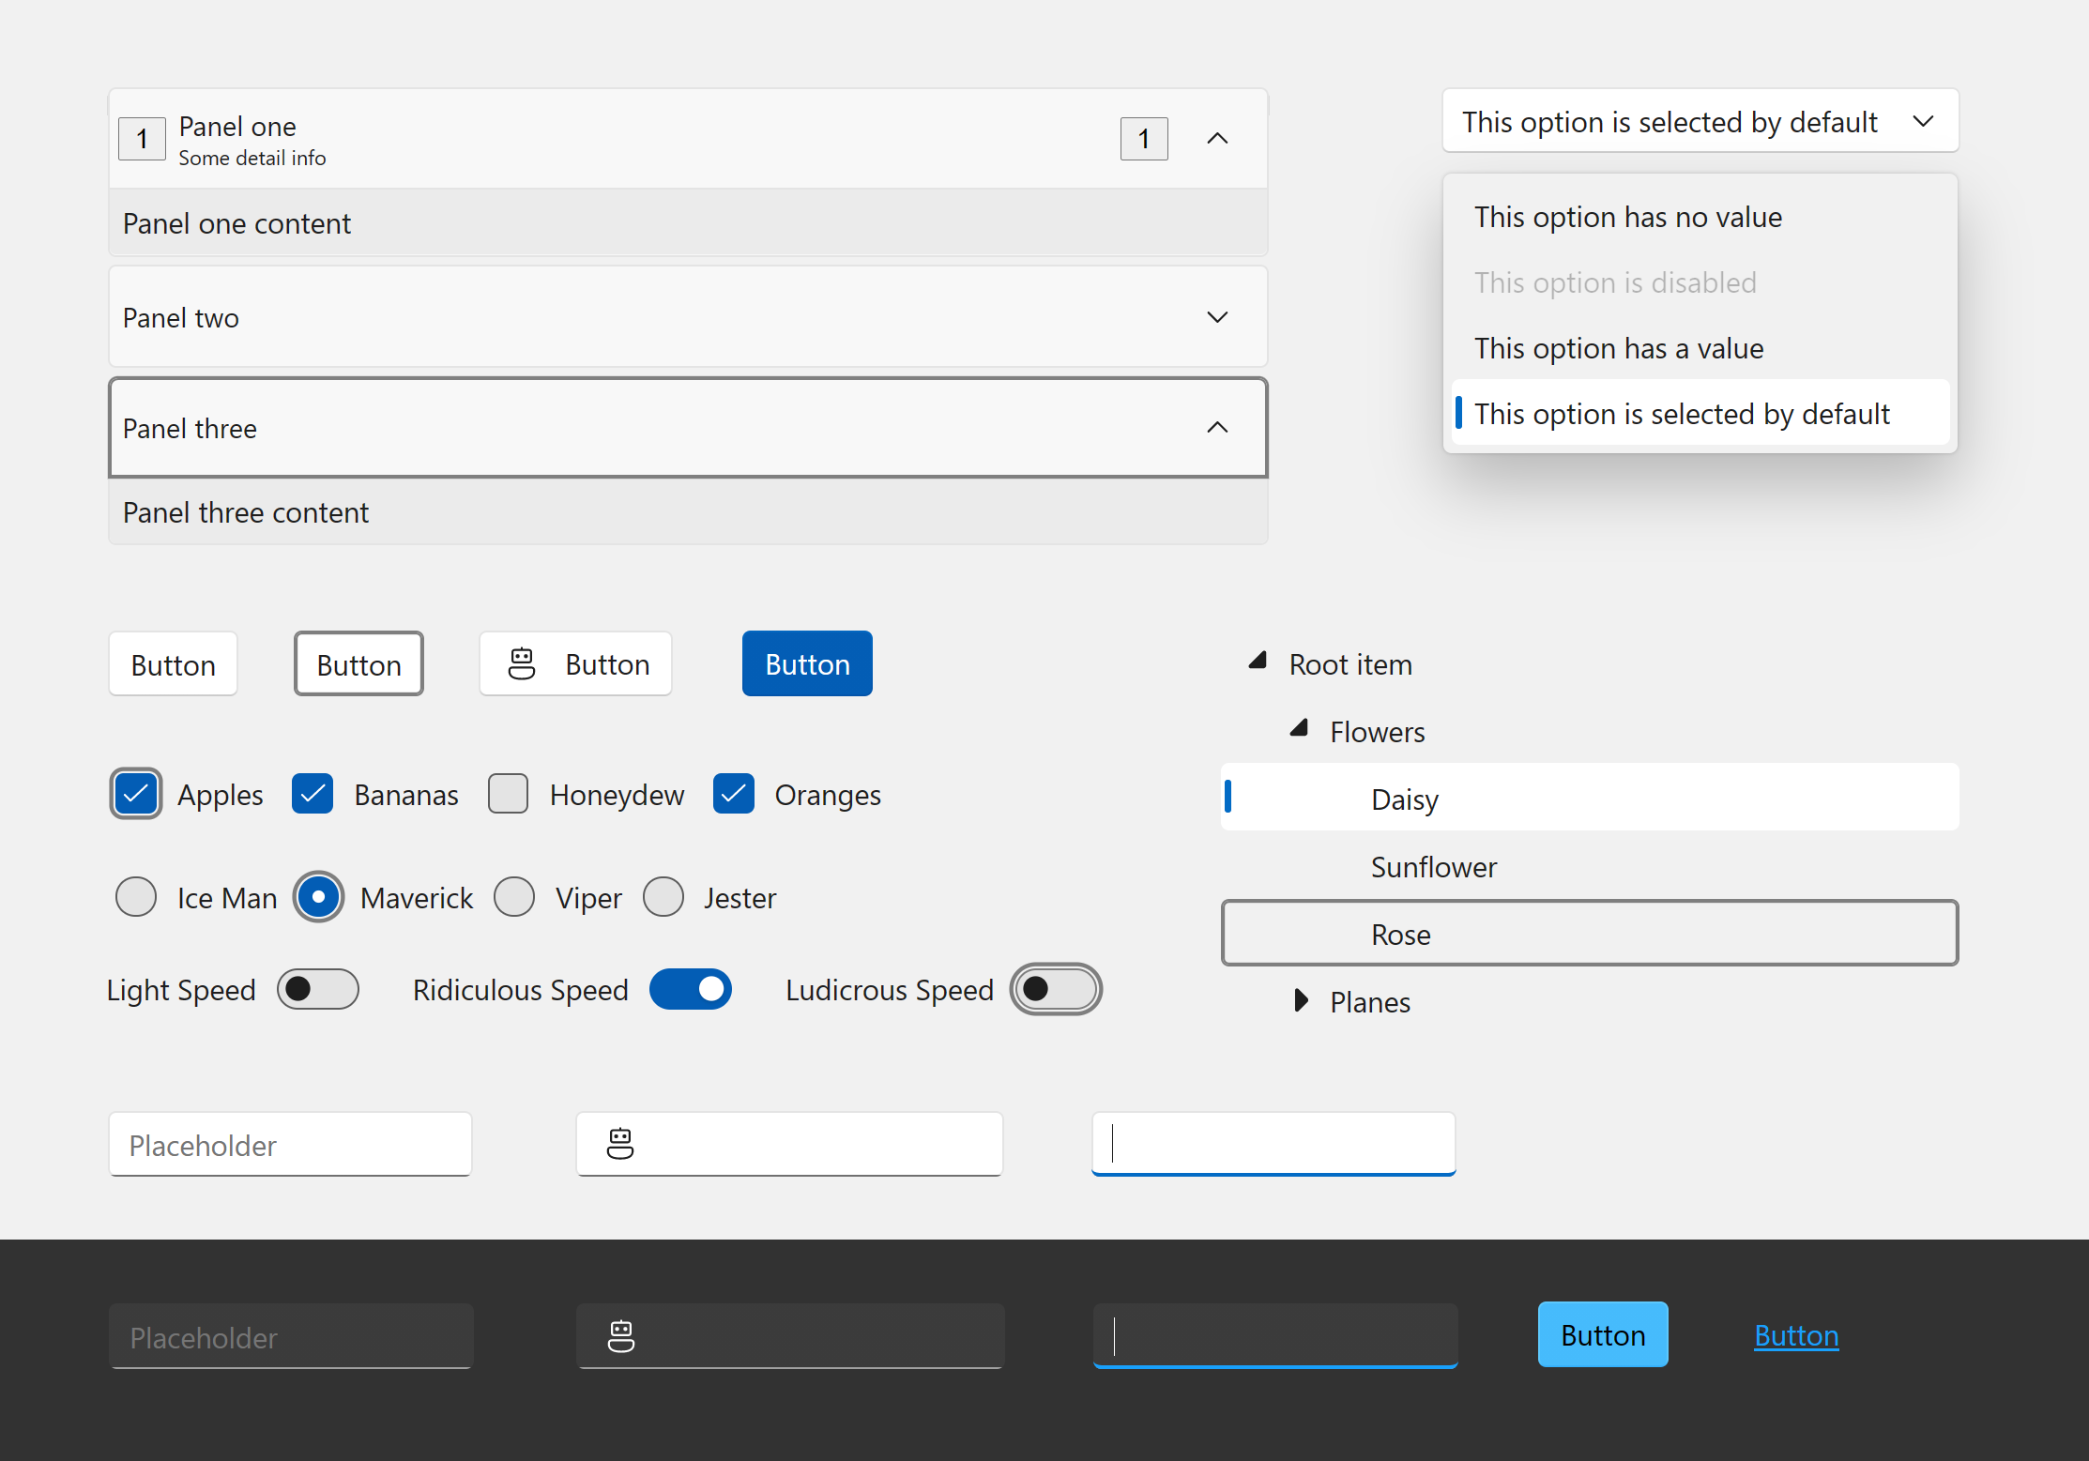
Blazor Fluent UI Components
40+ Blazor components
Fully accessible with light, dark, and high contrast modes
Default styles match the latest Windows 11 Fluent visuals
Integration with web, Windows, Teams, Office, and more
aka.ms/blazor-fluent-ui
Notes:
I’m also happy to announce that the Blazor Fluent UI components have released with over 40 new controls. Fully accessible and styles matching the latest Window 11 fluent visuals.
Check them out and use them in your Blazor apps.

Slide 21




.NET Multi-platform App UI
.NET 6
Cross-platform, native UI
Single project system, single codebase
Deploy to multiple devices, mobile & desktop
General availability early next year
.NET MAUI
WinUI
Mac Catalyst
iOS
Android
macOS
iOS
github.com/dotnet/maui
Notes:
Next I want to talk about .NET MAUI.
.NET MAUI is the evolution of Xamarin.Forms designed to help you deliver high-performance, cross-platform, native desktop & mobile apps all from a single codebase.
.NET MAUI under the hood uses technologies out there today for building native apps on Windows with WinUI, Mac Catalyst for macOS, and of course, iOS and Android. .NET MAUI abstracts all those frameworks into a single framework built on .NET 6.
.NET MAUI on Windows supports WinUI allowing these apps to use all the newest native features on supported versions of Windows 10.
That means you can build all these apps for any device from a single codebase and project system. Instead of learning different stacks and languages for each, you can use one language, one set of libraries, and one UI stack for all of them.
It will release early spring next year. You can watch the progress and help contribute on GitHub in the /dotnet/maui repo.

Slide 22
Hybrid apps with Blazor & .NET MAUI
Blazor
Reuse UI components across native and web
Built on top of .NET Multi-platform App UI
Native app container & embedded controls
General availability early next year
Can use native app
container & controls
.NET MAUI
macOS
iOS
Notes:
We first supported Blazor on the server, then in the browser with WebAssembly. Now we’re extending it again so you can write Blazor hybrid apps. This means you can create hybrid client apps, which combine web and native UI together in a single native client application. It is primarily targeted at web developers that want to provide rich client and offline experiences for their users.
Blazor hybrid apps is built on top of .NET MAUI.
It relies on that UI stack for a native application container and native controls should you want to use them. Blazor desktop apps have full access to the machine. You can do things like call native API's, access the file system, write multi-threaded applications – all with the high-performance and optimal memory consumption you get with .NET. You can't do this with pure web technologies.
These scenarios will also be supported when .NET MAUI releases early next year.

Slide 23
Simplified development
Notes:
6 min mark
Now let’s talk about how .NET 6 has made development simpler….

Slide 24
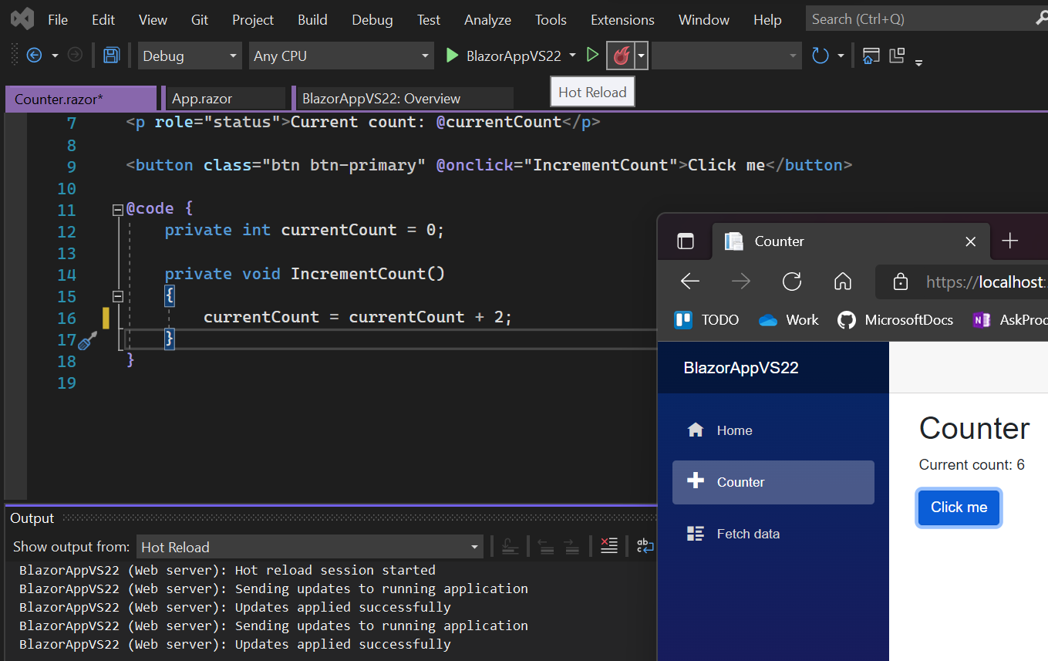
Hot reload everywhere
Speeds up your development, no more F5
Less time restarting, more time coding
Available in CLI & Visual Studio 2022
All project types, all .NET versions 4.6+
Best with .NET 6
Notes:
One of my favorite features is hot reload. And we’ve enabled it everywhere.
Hot Reload is NOT Just for .NET 6 developers, it works on multiple project types and all .NET versions (4.6 and higher) that support edit and continue.
.NET 6 is the most optimized for the best Hot Reload experience, such as Razor editing, CSS Hot Reload, most supported edits, ability to use Hot Reload when starting the app without the debugger (CTRL-F5), hot reload through dotnet watch CLI and Blazor and .NET MAUI project support.

Slide 25
Simplify your code with C# 10
global using Model; // Global usings apply to entire project
// using System; // Implicit usings for each project type
namespace Model; // File-scope namespace, no indentation needed
// Records can be structs as well as classes
public record struct Order(Customer Customer, string Kind, int Items);
public record class Customer(string Name, string Address);
// Lambdas have types
var parse = (string s) => int.Parse(s); // Func<string, int>
Notes:
Now let’s talk about C#! From now on, we’ll release a new major version of C# every year along with each version of .NET. This allows us to ship small features more frequently, getting value to you faster.
C# 10 has a strong focus on simplification.
Global usings are usings that you write once and they apply to your whole project
Project types offer implicit usings so you don’t need to type them anywhere
File-scoped namespaces apply to the whole file; no indentation needed
Records can now be structs
You can say that records are classes instead of leaving it implied
Lambdas that contain enough type information have their own types

Slide 26
Minimal APIs for cloud native apps
Lightweight, single-file, cloud native APIs
Low ceremony, top-level C# programs
Easy to get started
Path to MVC
var app = WebApplication.Create(args);
app.MapGet("/", () => "Hello World!");
app.Run();
Minimal code for minimal apps
Notes:
For .NET 6 we’ve built upon C# top-level programs to provide you with a lightweight way to build ASP.NET web APIs with minimal code.
No usings, no class definitions needed, this is an easy way to build APIs that can immediately take advantage of cloud scale without all the ceremony and setup code of traditional controller-style web APIs.
And when your project starts to get too big, we’ll provide a path move these to ASP.NET MVC controllers. It’s just another option for quickly building APIs that don’t need the all the bells and whistles of controllers and startup classes.

Slide 27

.NET Upgrade Assistant
RELEASED
+40K
preview downloads
Reduce time and difficulty modernizing older .NET codebases
Guided, step-by-step experience
Multiple project types supported
C# & VB.NET languages
Supports .NET 6
aka.ms/dotnet-upgrade-assistant
Notes:
To help you move to .NET 6, we’ve released the .NET Upgrade Assistant. It helps you modernize older .NET Framework codebases. It's a command line tool that gives you step-by-step instructions for upgrading to the latest versions of .NET.
We’ve had over 40K downloads of the preview version. Customers like Episerver Optimizely have given us a lot of great feedback through the preview period and now we’re ready to make it generally available.
It now supports C# and VB.NET languages and .NET 6. We’re seeing customers use it very successfully today, so I encourage you to give it a try.
But if you are unable to upgrade at this point that’s OK. We’re shipping an update for the .NET Framework, version 4.8.1. It will add support for ARM64, enhancements to accessibility, and other security and reliability improvements. It will be available as part of Windows Insider Preview builds over the coming months.

Slide 28
What is not in .NET 6?
Web forms, WCF server and Windows workflow remain on .NET Framework 4.8 only. There are no plans to port these.
Recommendations
ASP.NET Blazor for ASP.NET Web forms (we will provide a migration guide)
gRPC for WCF server and remoting (we will provide a migration guide)
Open source core workflow for Windows workflow (WF): https://github.com/UiPath/corewf
Notes:
Now let’s talk about C#! From now on, we’ll release a new major version of C# every year along with each version of .NET. This allows us to ship small features more frequently, getting value to you faster.
C# 10 has a strong focus on simplification.
Global usings are usings that you write once and they apply to your whole project
Project types offer implicit usings so you don’t need to type them anywhere
File-scoped namespaces apply to the whole file; no indentation needed
Records can now be structs
You can say that records are classes instead of leaving it implied
Lambdas that contain enough type information have their own types

Slide 29
.NET Schedule
July 2019
.NET Core 3.0
RC
Sept 2019
.NET Core 3.0
Nov 2019
.NET Core 3.1
LTS
Nov 2020
.NET 5.0
Nov 2021
.NET 6.0
LTS
Nov 2022
.NET 7.0
Nov 2023
.NET 8.0
LTS
.NET 6.0 release LTS (long-term-support) release in November 2021
Major releases every year, LTS for even numbered releases
Predictable schedule, minor releases if needed

Slide 30
.NET CLI
Notes:
6 min mark
Now let’s talk about how .NET 6 has made development simpler….

Slide 31
What are the .NET command-line tools?
Cross-platform command-line set of tools that are…
…focused on building code…
…for both humans…
…and machines

Slide 32
CLI commands: basic architecture
dotnet
build
--output [path]
the driver
verb (command)
verb arguments

Slide 33
CLI commands: architecture explained
Driver, dotnet, is invoked first, followed by a verb
The verb is a command that is implemented as:
A NuGet package
A binary in the $PATH
Driver invokes the command passing the arguments to it
The command is responsible for the arguments

Slide 34
.NET SDK Commandline Usage (1/2)
Command | Purpose
dotnet new | Initialize .NET projects.
dotnet restore | Restore dependencies specified in the .NET project.
dotnet run | Compiles and immediately executes a .NET project.
dotnet build | Builds a .NET project.
dotnet publish | Publishes a .NET project for deployment (incl. runtime).
dotnet test | Runs unit tests using the test runner specified in the project.
dotnet pack | Creates a NuGet package.
dotnet migrate | Migrates project.json project to msbuild based project.

Slide 35
.NET SDK Commandline Usage (2/2)
Command | Purpose
dotnet clean | Clean build output(s).
dotnet sln | Modify solution (SLN) files.
dotnet add | Add reference to the project.
dotnet remove | Remove reference from the project.
dotnet list | List reference in the project.
dotnet nuget | Provides additional NuGet commands.
dotnet msbuild | Runs Microsoft Build Engine (MSBuild).
dotnet vstest | Runs Microsoft Test Execution Command Line Tool.

Slide 36

Get started today!
Download .NET 6
Download Visual Studio 2022
Use the Upgrade Assistant
Try out the MAUI preview
Have a great conference!
get.dot.net/6
VisualStudio.com/download
aka.ms/dotnet-upgrade-assistant
VisualStudio.com/preview
Ask questions on Twitter #dotNETConf

